Slide 1

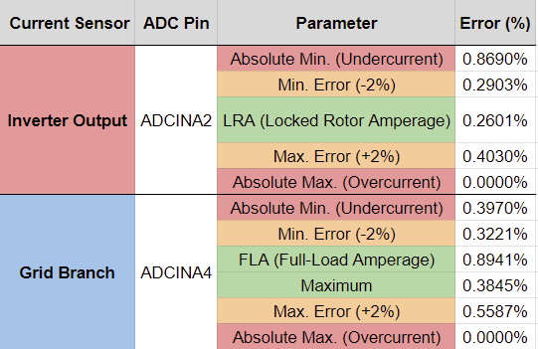
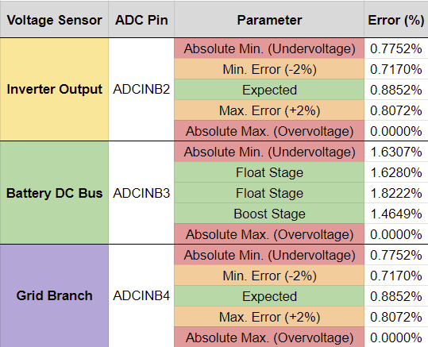
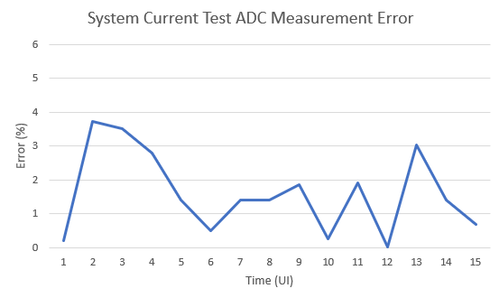
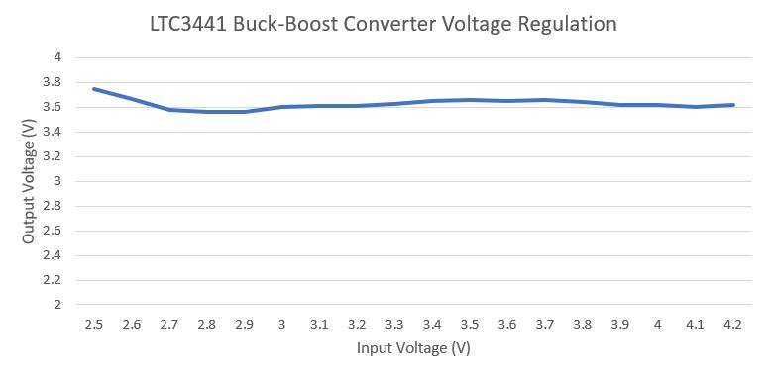
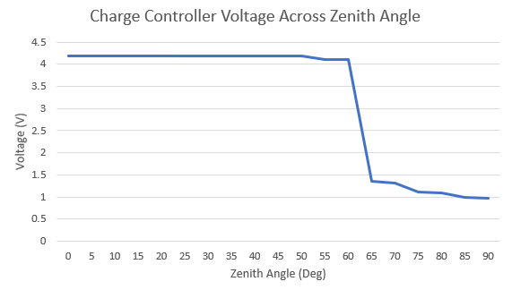
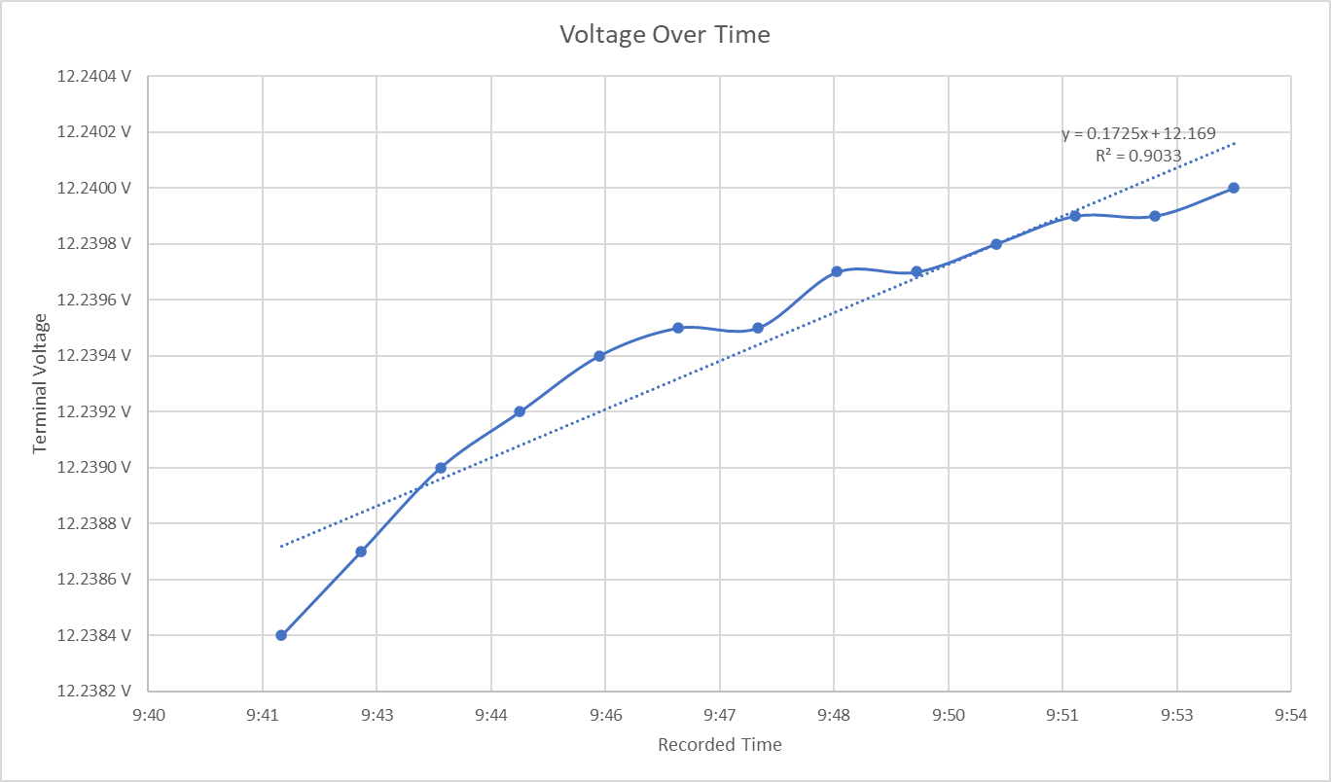
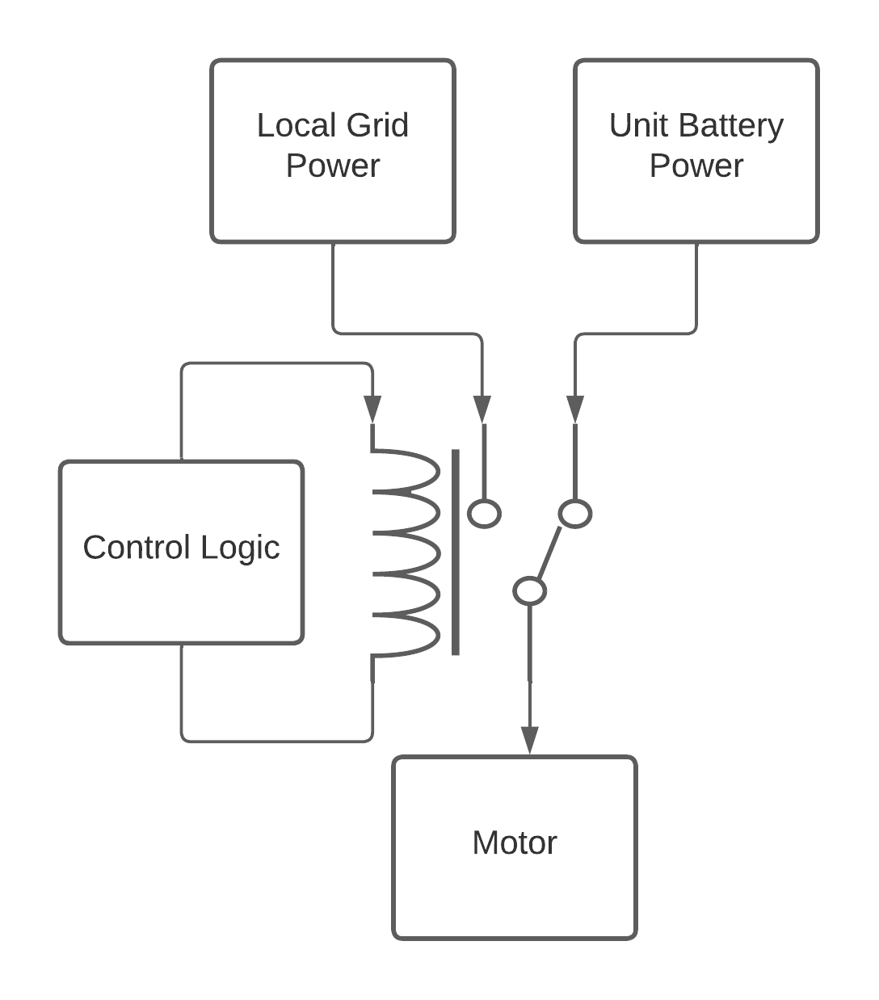
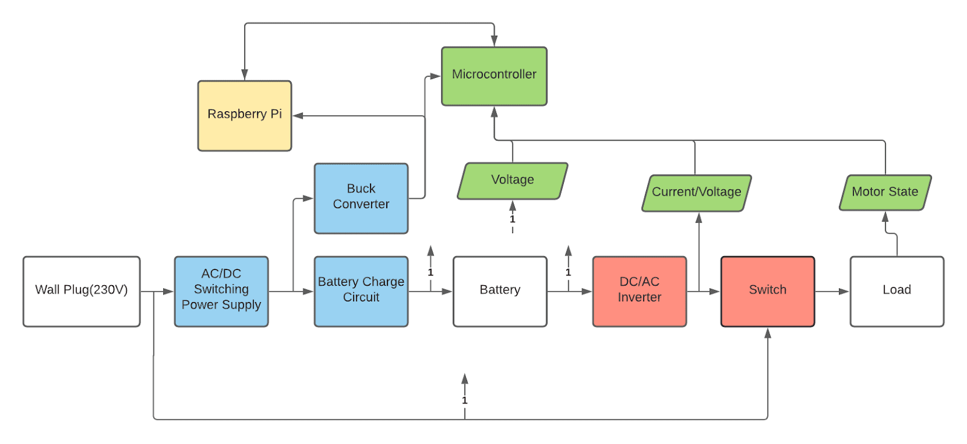
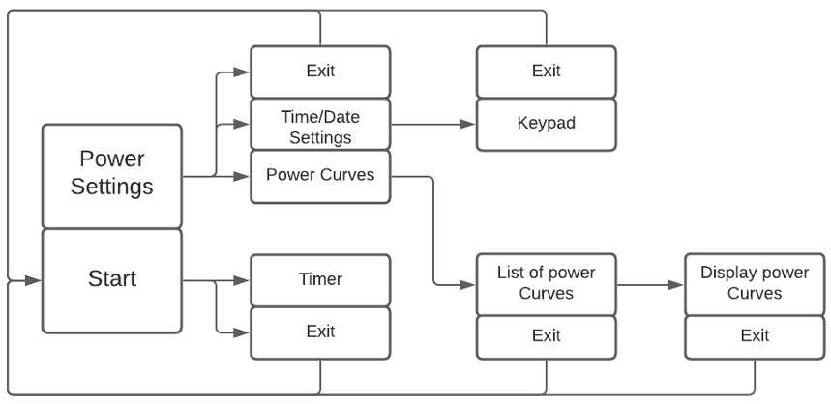
EPS Booth: 320
Hybrid Start
Leo Predanic, Brandon Cenci, George Thuita
Dr. John Lusher II, P.E.
Problem Definition
Motors draw large amounts of power during their start-up phase, causing brownouts/dancing powerlines and strain on remote power grid systems. Our project provides a reliable solution to aid in reducing inrush current through the design of a hybrid single-phase motor starter. The advantage of this system lies in its ability to store/draw energy from both a storage unit and the grid instead of being limited to the latter, thus maximizing efficiency and longevity.
Engineering Analysis
Operation Modes
Standby – In this mode, the unit charges the battery and monitors charge level.
Startup – In this mode, the unit disconnects the battery, runs power through the inverter, and is monitored via sensors.
Grid Mode – In this mode, the unit switches power from the battery and inverter to get power directly from the local grid and charges battery.
Design Parameters
Motor FLA – Providing ~5 A via grid connection.
Motor LRA – Providing ~22 A via battery unit.
Battery capacity – 85 Ah total capacity.
Power supply rating – Provides 10 A maximum to system loads.
Inverter Rating - Inverter is rated to handle 2000 W AC-DC conversion with 12 V – 230 V step-up.
SPI Communication
The purpose of this unit was to record current and voltage values during start up so that they could be communicated to the user later in the form of a graph (see Fig. 3).
Outcomes
Start-Up
It (half) works! The battery begins charging when the system is plugged in. The user can start the system through the digital interface, which first uses the battery to start the motor. Once the motor is in operation, the switching circuit should switch the power source from the battery to the grid. However, we were unable to run it past the start-up cycle due to shorts and connection issues.
(a)
(b)
Table 1. Percent errors in sensed values obtained from (a) current sensors, and (b) voltage sensors.
Impact
By providing a sustainable and reliable solution to the strain placed on the power grid, Hybrid Start strives to alleviate the following scenarios:
Rural areas with limited grid access: Rural areas may have insufficient power required for starting machines. However, the system is able to switch between power sources, allowing for continuous energy.
Areas with insecure power grids: Insecure power grids may cause inconsistencies in machine operation. The system allows for energy obtained from the grid to be stored for later use at any time.
Offshore applications: Offshore oil platforms are powered by generators typically inefficient with fuel usage. To avoid potentially hazardous voltage drops, the system is powered in an isolated configuration separate from other facilities.
Power Capabilities The unit has shown through extensive testing that it is capable of supplying and storing all the power required to operate. The switching power supply can power all peripherals and the internal storage is capable of running the motor through several startup cycles. Charging data for the battery is provided in the figure below.
Methodology
The Hybrid Start is comprised of 4 subsystems:
Grid Input-to-Storage
Connection to the local grid splits at a bus going to an AC/DC power supply and a switch in the storage-to-output subsystem. The power supply is connected to a buck converter, linear regulator, and the battery.
Storage-to-Output
The battery is connected to an inverter which connects to a step-up transformer, followed by an automatic transfer switch.
Controls/Monitoring
Provides periodic monitoring data of the system and enables power source switching using current, voltage, and Hall sensors; lies central to system operation and interfacing.
Digital User Interface
Enables user to start, emergency stop, change date and time, and view past current and voltage values.
Figure 4. Battery charging plot
Sensing The microcontroller is successfully able to read the voltage, current, and motor status levels accurately with very little error by converting the analog output of the sensors into digital values via its ADC modules (see Table 1). With fault detection techniques implemented, the microcontroller is able to successfully deactivate the system under fault conditions (i.e., overcurrent, overvoltage, shorts), or when the sensed values exceed a specified threshold in adherence to NFPA-70 standards.
References
Texas Instruments, “TMS320F2837xD Dual-Core Delfino™ Microcontrollers,” TMS320F2837xD Datasheet, Dec. 2013 [Revised Nov. 2015].
Texas Instruments, “TMS320F2837xD Dual-Core Delfino™ Microcontrollers,” TMS320F2837xD Technical Reference Manual, Dec. 2013 [Revised Nov. 2015].
Texas Instruments, “LAUNCHXL-F28379D Overview,” LAUNCHXL-F28379D User’s Guide, Aug. 2016 [Revised Mar. 2019].
Nidec, “R063DSE0298R13J Motor Datasheet,” Motor Model: R063MWDSE0298, October. 2021
Figure 2. Switching behavior diagram
Acknowledgements
Thank you to Dr. John Lusher, Stavros Kalafatis, Dr. Wonhyeok Jang, Souryendu Das, Bryton Praslicka, and Farid Naghavi for your continued support and guidance throughout the year.
Figure 3. Digital interface GUI flowchart
Figure 1. System diagram

